Slide 1
Measuring Effects of Staffing Patterns and Salary on Completion Rates in Higher Education
Matthew Fikes
DSC530

Slide 2
Questions
Does the amount of salary paid have any effect on completions awarded by an educational institution?
Does the type of employee matter when predicting completions? Instructional Staff, Non-Instructional Staff, and Educational Support Staff in particular.
Do any other school characteristics affect the number of completions?

Slide 3
Datasets
All datasets and definitions are from the National Center for Education Statistics Integrated Postsecondary Data System (http://nces.ed.gov/ipeds/).
Institutional Characteristics Dataset
Directory Information: Academic year 2018-2019
Instructional Staff/Salaries Datasets
Number and salary outlays for full-time nonmedical instructional staff, by gender, and academic rank: Academic year 2018-19 (revised February 2021)
Number and salary outlays for full-time nonmedical noninstructional staff by occupation: Academic year 2018-19 (revised February 2021)
Completions Dataset
Number of students receiving awards/degrees, by award level and by gender, race/ethnicity and age categories: July 1, 2018 to June 30, 2019

Slide 4
Institutional Characteristics Dataset Variables
UNITID
Unique identification number of the institution
OBEREG
Bureau of Economic Analysis (BEA) Regions Count:3923 unique:9.0 top:5.0 freq:963.0
BEA Regions are a set of Geographic Areas that are aggregations of the states. The regional classifications, which were developed in the mid-1950s, are based on the homogeneity of the states in terms of economic characteristics, such as the industrial composition of the labor force, and in terms of demographic, social, and cultural characteristics. BEA groups all 50 states and the District of Columbia into eight distinct regions for purposes of data collecting and analyses. IPEDS/HEGIS assigns U.S. service schools as their own region. Value Description
0 US Service schools 1 New England CT ME MA NH RI VT 2 Mid East DE DC MD NJ NY PA 3 Great Lakes IL IN MI OH WI 4 Plains IA KS MN MO NE ND SD 5 Southeast AL AR FL GA KY LA MS NC SC TN VA WV 6 Southwest AZ NM OK TX 7 Rocky Mountains CO ID MT UT WY 8 Far West AK CA HI NV OR WA 9 Outlying areas AS FM GU MH MP PR PW VI -3 Not available
HDEGOFR1
A code for highest degree offered at the institution
Count:3929 unique:7 top:40 freq:1302
This variable was revised in 2009 because the first professional category is no longer an award level and the Doctoral award level category has expanded to 3 categories, Doctor's degree - Research/scholarships, Doctor's degree - professional practice and Doctor's degree-other. This variable is derived from the level of offering variables (LEVEL1-LEVEL8 LEVEL12 and LEVEL17-LEVEL19) from the Institutional Characteristics component.
Value Description 11 Doctor's degree - research/scholarship and professional practice
12 Doctor's degree - research/scholarship
13 Doctor's degree - professional practice
14 Doctor's degree - other
20 Master's degree
30 Bachelor's degree
40 Associate's degree

Slide 5
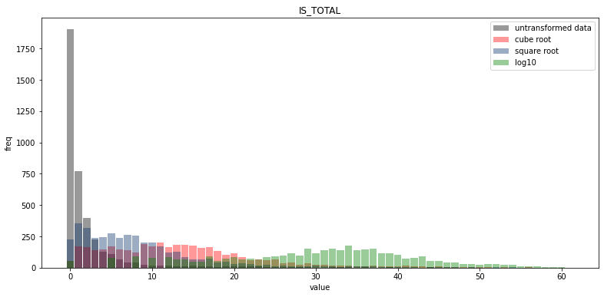
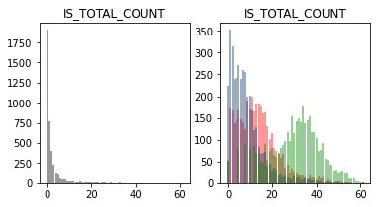
Instructional Staff/Salaries Dataset Variables – IS_TOTAL
Description
Original Variable: SAINSTT
Number of full-time, non-medical, instructional staff - total as of November 1, on 9, 10, 11 or 12 month contract and less less-than 9-month contract. Instructional Staff- An occupational category that consists of the following two functions: 1) "Instruction" only and 2) "Instruction combined with research and/or public service Contract length - The contracted teaching period. The number of months should correspond with the number of months worked (which may differ from the number of months over which staff are paid). Excludes medical staff - Staff employed by or staff working in the medical school (Doctor of Medicine [M.D.] and/or Doctor of Osteopathic Medicine [D.O.]) component of a postsecondary institution or in a free standing medical school. Does not include staff employed by or employees working strictly in a hospital associated with a medical school or those who work in health or allied health schools or departments such as dentistry, veterinary medicine, nursing or dental hygiene unless the health or allied health schools or departments are affiliated with (housed in or under the authority of) the medical school
Tails:
Smallest: 2 52
Smallest: 4 79
Smallest: 6 92
Smallest: 8 81
Smallest: 10 86
Smallest: 12 69
Smallest: 14 69
Smallest: 16 47
Smallest: 18 48
Smallest: 20 51
Largest: 7768 1
Largest: 6092 1
Largest: 5988 1
Largest: 5628 1
Largest: 5516 1
Largest: 5260 1
Largest: 5012 1
Largest: 4964 1
Largest: 4740 1
Largest: 4576 1
Mean: 325.962840417409
Mode: [6]
Spread: 364932.10246238066

Slide 6
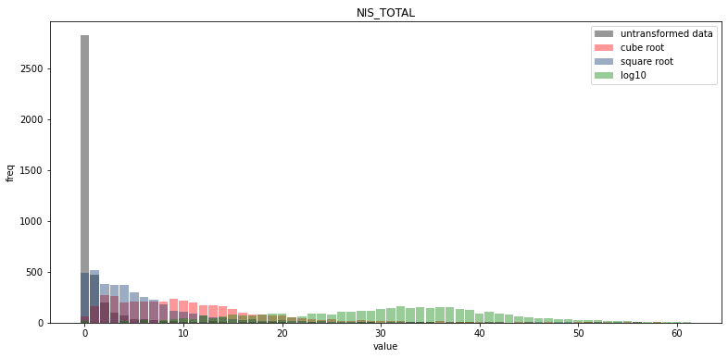
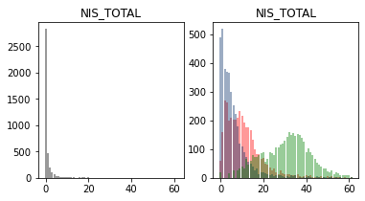
Instructional Staff/Salaries Dataset Variables – NIS_TOTAL
Description
Original Variable Name: SANIN01
Number of full-time, non-medical, non-instructional staff
Excludes medical staff - Staff employed by or staff working in the medical school (Doctor of Medicine [M.D.] and/or Doctor of Osteopathic Medicine [D.O.]) component of a postsecondary institution or in a free standing medical school. Does not include staff employed by or employees working strictly in a hospital associated with a medical school or those who work in health or allied health schools or departments such as dentistry, veterinary medicine, nursing or dental hygiene unless the health or allied health schools or departments are affiliated with (housed in or under the authority of) the medical school
Mean: 2184.0171136653894
Mode: [12.]
Spread: 1667115.11669301
Tails:
Smallest: 4.0 15
Smallest: 8.0 24
Smallest: 10.0 32
Smallest: 12.0 40
Smallest: 14.0 30
Smallest: 16.0 29
Smallest: 18.0 38
Smallest: 20.0 39
Smallest: 22.0 28
Smallest: 24.0 32
Largest: 68992.0 1
Largest: 57834.0 1
Largest: 57645.0 1
Largest: 50748.0 1
Largest: 49482.0 1
Largest: 49440.0 1
Largest: 45762.0 1
Largest: 45486.0 1
Largest: 45458.0 1
Largest: 44387.0 1

Slide 7
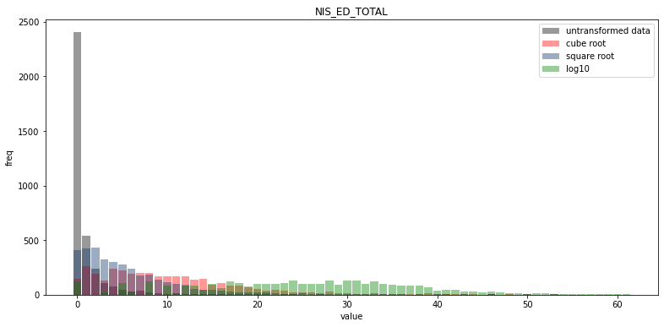
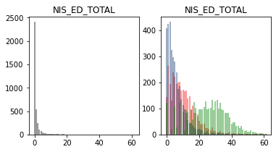
Instructional Staff/Salaries Dataset Variables – NIS_ED_TOTAL
Description
Original Variable: SANIT04
This variable includes the following four SOC categories Archivists, Curators, and Museum Technicians - An occupational category based on the broad occupation in the 2010 Standard Occupational Classification (SOC) Manual called "Archivists, Curators, and Museum Technicians." For detailed information, refer to the following website: http://www.bls.gov/soc/2010/soc254010.htm. Librarians - An occupational category based on the broad occupation in the 2010 Standard Occupational Classification (SOC) Manual called "Librarians." For detailed information, refer to the following website: http://www.bls.gov/soc/2010/soc254020.htm Library Technicians An occupational category based on the broad occupation in the 2010 Standard Occupational Classification (SOC) Manual called "Library Technicians." For detailed information, refer to the following website: http://www.bls.gov/soc/2010/soc254030.htm. Academic Affairs and Other Education Services Occupations - An occupational category based on the following three minor groups in the 2010 Standard Occupational Classification (SOC) Manual: 1) Pre-school, Primary, Secondary, and Special Education School Teachers (http://www.bls.gov/soc/2010/soc250000.htm#25-2000); 2) Other Teachers and Instructors (http://www.bls.gov/soc/2010/soc250000.htm#25-3000); and 3) Other Education, Training, and Library Occupations (http://www.bls.gov/soc/2010/soc250000.htm#25-9000).
Tails:
Smallest: 2.0 123
Smallest: 3.0 22
Smallest: 4.0 109
Smallest: 5.0 28
Smallest: 6.0 126
Smallest: 8.0 85
Smallest: 9.0 17
Smallest: 10.0 93
Smallest: 12.0 87
Smallest: 15.0 43
Largest: 6510.0 1
Largest: 4599.0 1
Largest: 4356.0 1
Largest: 3858.0 1
Largest: 2190.0 1
Largest: 2010.0 1
Largest: 1860.0 1
Largest: 1825.0 1
Largest: 1330.0 1
Largest: 1212.0 1
Mean: 219.22114853672005
Mode: [6.]
Spread: 319043.1534677034

Slide 8
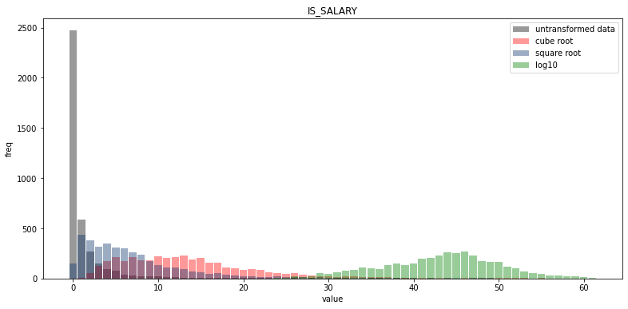
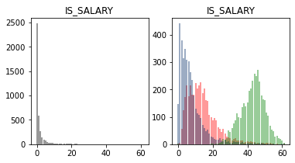
Instructional Staff/Salaries Dataset Variables – IS_SALARY
Description
Original Variable: SAOUTLT
"Total salary outlays of full-time, non-medical, instructional staff as of November 1.Instructional Staff- An occupational category that consists of the following two functions: 1) ""Instruction"" only and 2) ""Instruction combined with research and/or public serviceAnnual salary outlays (combined salaries of all staff) include base salaries only – no supplements, overloads or bonuses. Additional stipends for administrative, managerial or other responsibilities are NOT included in the salary outlays data for instructional staff.Excludes medical staff - Staff employed by or staff working in the medical school (Doctor of Medicine [M.D.] and/or Doctor of Osteopathic Medicine [D.O.]) component of a postsecondary institution or in a free standing medical school. Does not include staff employed by or employees working strictly in a hospital associated with a medical school or those who work in health or allied health schools or departments such as dentistry, veterinary medicine, nursing or dental hygiene unless the health or allied health schools or departments are affiliated with (housed in or under the authority of) the medical school"
Tails:
Smallest: 18480.0 1
Smallest: 42800.0 1
Smallest: 46000.0 1
Smallest: 60000.0 1
Smallest: 62000.0 1
Smallest: 110000.0 1
Smallest: 121892.0 1
Smallest: 126000.0 1
Smallest: 127416.0 1
Smallest: 128000.0 1
Largest: 884005276.0 1
Largest: 845502116.0 1
Largest: 702401008.0 1
Largest: 696646240.0 1
Largest: 647943372.0 1
Largest: 642404422.0 1
Largest: 631490374.0 1
Largest: 591936132.0 1
Largest: 581566838.0 1
Largest: 564673024.0 1
Mean: 29062043.586452764
Mode: [160000. 240000.]
Spread: 4762759104709779.0

Slide 9
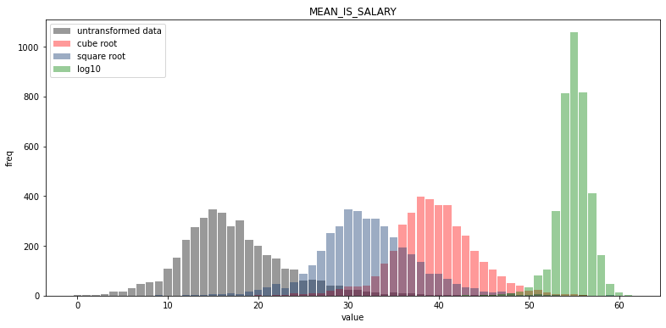
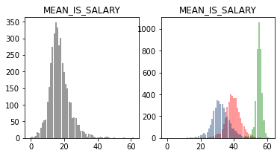
Instructional Staff/Salaries Dataset Variables – MEAN_IS_SALARY
Description
Calculated variable dividing total count of Instructional Staff by total salary outlay for Instructional Staff
Mean: 68895.1781134893
Mode: [40000.]
Spread: 553564616.1951375
Tails:
Smallest: 1.0 1
Smallest: 1664.9743 1
Smallest: 4533.0 1
Smallest: 5609.3333 1
Smallest: 6000.0 1
Smallest: 9240.0 2
Smallest: 9901.0 1
Smallest: 10700.0 1
Smallest: 12000.0 1
Smallest: 12007.375 1
Largest: 240679.1294 1
Largest: 220718.3297 1
Largest: 218433.0327 1
Largest: 197303.6539 1
Largest: 183730.6965 1
Largest: 182116.1943 1
Largest: 181669.1521 1
Largest: 181363.8620 1
Largest: 177422.9016 1
Largest: 175000.0 1

Slide 10
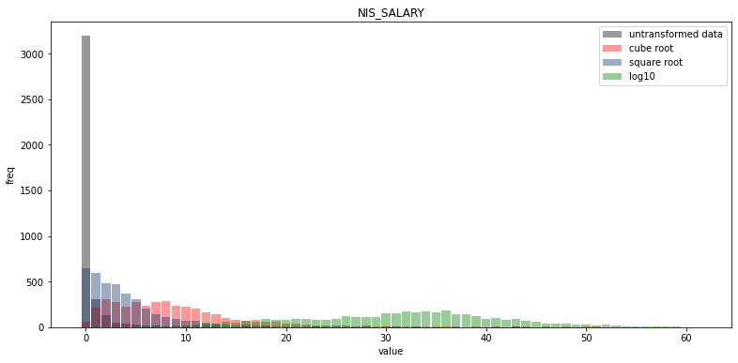
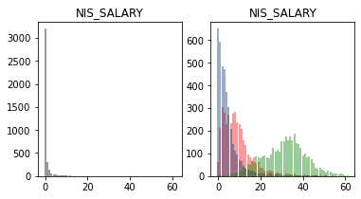
Instructional Staff/Salaries Dataset Variables – NIS_SALARY
Description
Original Variable: SANIT01
Salary outlays for full-time, non-medical, non-instructional staff
Excludes medical staff - Staff employed by or staff working in the medical school (Doctor of Medicine [M.D.] and/or Doctor of Osteopathic Medicine [D.O.]) component of a postsecondary institution or in a free standing medical school. Does not include staff employed by or employees working strictly in a hospital associated with a medical school or those who work in health or allied health schools or departments such as dentistry, veterinary medicine, nursing or dental hygiene unless the health or allied health schools or departments are affiliated with (housed in or under the authority of) the medical school
Mean: 137184909.71315452
Mode: [ 100000. 240000. 500000. 628000. 948440. 1140000.]
Spread: 2.0566269023082285e+17
Tails:
Smallest: 85798.0 1
Smallest: 211244.0 1
Smallest: 390934.0 1
Smallest: 392000.0 1
Smallest: 466000.0 1
Smallest: 512404.0 1
Smallest: 575088.0 1
Smallest: 677150.0 1
Smallest: 726438.0 1
Smallest: 737080.0 1
Largest: 7463928346.0 1
Largest: 6312694134.0 1
Largest: 5658335018.0 1
Largest: 5194017750.0 1
Largest: 5097197700.0 1
Largest: 4768323511.0 1
Largest: 4427078172.0 1
Largest: 4354244232.0 1
Largest: 4279651866.0 1
Largest: 4250649078.0 1

Slide 11
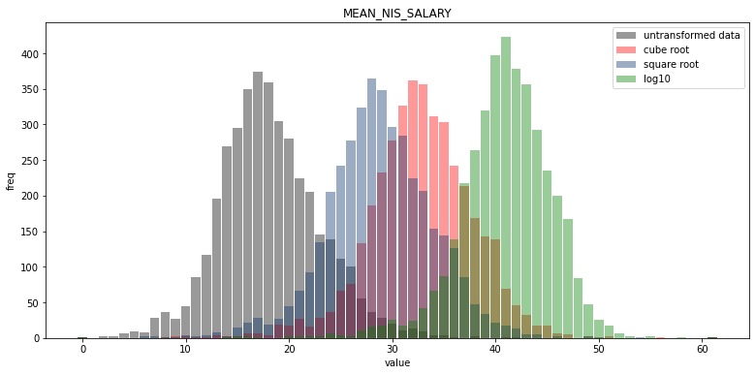
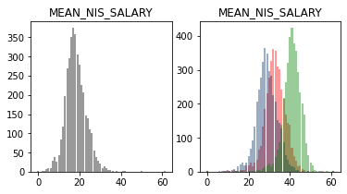
Instructional Staff/Salaries Dataset Variables – MEAN_NIS_SALARY
Description
Calculated variable dividing total count of Non-Instructional Staff by total salary outlay for Non-Instructional Staff
Mean: 55146.4453537939
Mode: [40000. 50000.]
Spread: 175502280.32359636
Tails:
Smallest: 5092.4285 1
Smallest: 11679.0 1
Smallest: 12000.0 1
Smallest: 12487.3902 1
Smallest: 13167.875 1
Smallest: 13332.5 1
Smallest: 14103.4684 1
Smallest: 15830.0 1
Smallest: 16092.5 1
Smallest: 16863.6904 1
Largest: 171248.75 1
Largest: 140192.9508 1
Largest: 120000.0 1
Largest: 117060.6667 1
Largest: 108512.8823 1
Largest: 108012.7584 1
Largest: 107146.8064 1
Largest: 102030.5833 1
Largest: 101544.8240 1
Largest: 100661.3421 1

Slide 12
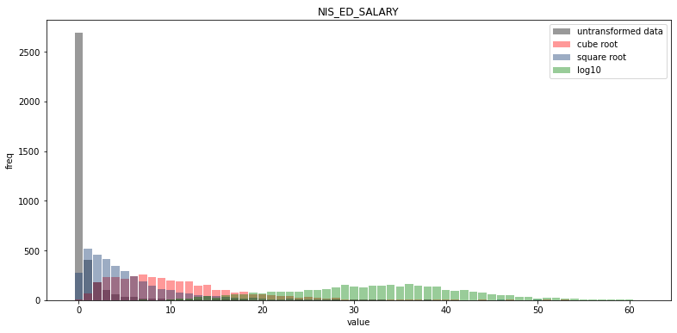
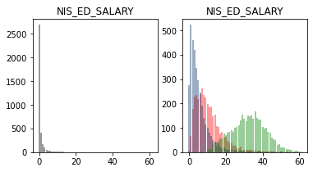
Instructional Staff/Salaries Dataset Variables – NIS_ED_SALARY
Description
Original Variable: SANIN04
This variable includes the following four SOC categories Archivists, Curators, and Museum Technicians - An occupational category based on the broad occupation in the 2010 Standard Occupational Classification (SOC) Manual called "Archivists, Curators, and Museum Technicians." For detailed information, refer to the following website: http://www.bls.gov/soc/2010/soc254010.htm. Librarians - An occupational category based on the broad occupation in the 2010 Standard Occupational Classification (SOC) Manual called "Librarians." For detailed information, refer to the following website: http://www.bls.gov/soc/2010/soc254020.htm Library Technicians An occupational category based on the broad occupation in the 2010 Standard Occupational Classification (SOC) Manual called "Library Technicians." For detailed information, refer to the following website: http://www.bls.gov/soc/2010/soc254030.htm. Academic Affairs and Other Education Services Occupations - An occupational category based on the following three minor groups in the 2010 Standard Occupational Classification (SOC) Manual: 1) Pre-school, Primary, Secondary, and Special Education School Teachers (http://www.bls.gov/soc/2010/soc250000.htm#25-2000); 2) Other Teachers and Instructors (http://www.bls.gov/soc/2010/soc250000.htm#25-3000); and 3) Other Education, Training, and Library Occupations (http://www.bls.gov/soc/2010/soc250000.htm#25-9000).
Tails:
Smallest: 136064.0 1
Smallest: 151299.0 1
Smallest: 192000.0 1
Smallest: 195188.0 1
Smallest: 195504.0 1
Smallest: 206400.0 1
Smallest: 208000.0 1
Smallest: 235582.0 1
Smallest: 264514.0 1
Smallest: 293756.0 1
Largest: 215238665.0 1
Largest: 213162048.0 1
Largest: 107032308.0 1
Largest: 54526812.0 1
Largest: 53579106.0 1
Largest: 44545605.0 1
Largest: 42164470.0 1
Largest: 28871118.0 1
Largest: 25210866.0 1
Largest: 17668584.0 1
Mean: 12093314.036443954
Mode: [90000.]
Spread: 1192291855932913.8

Slide 13
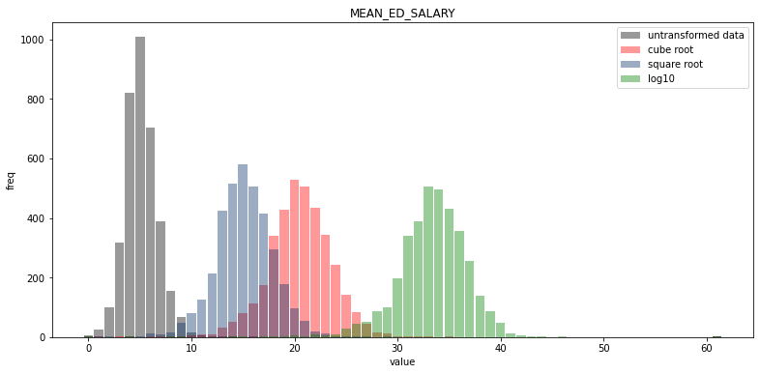
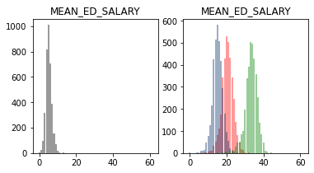
Instructional Staff/Salaries Dataset Variables – MEAN_ED_SALARY
Description
Calculated variable dividing total count of Educational Support Staff by total salary outlay for Educational Support Staff
Mean: 49496.22883152884
Mode: [45000.]
Spread: 231332128.66771415
Tails:
Smallest: 2706.25 1
Smallest: 3832.0 1
Smallest: 5400.0 1
Smallest: 6184.3076 1
Smallest: 9070.3333 1
Smallest: 9728.0 1
Smallest: 10200.0 1
Smallest: 12237.473 1
Smallest: 12744.25 1
Smallest: 13000.0 1
Largest: 516211.1923 1
Largest: 139575.0 1
Largest: 119227.0 1
Largest: 116803.916 1
Largest: 114097.8461 1
Largest: 106426.6153 1
Largest: 101482.0 1
Largest: 99734.6101 1
Largest: 96647.0569 1
Largest: 96435.5 1

Slide 14
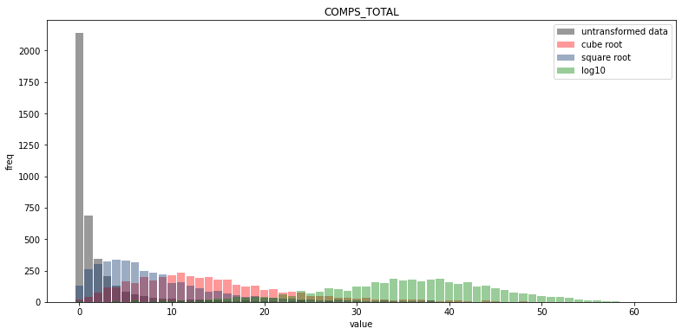
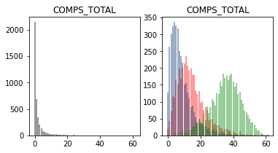
Completion Dataset Variables – COMPS_TOTAL
Description
Original Variable: CSTOTLT
Number of students receiving awards/degrees conferred between July 1, 2018 and June 30, 2019 to all recipients, across all race/ethnicities and both genders
Mean: 1201.1231865614661
Mode: [66]
Spread: 4882464.0596532775
Tails:
Smallest: 1 4
Smallest: 2 6
Smallest: 3 9
Smallest: 4 4
Smallest: 5 14
Smallest: 6 7
Smallest: 7 12
Smallest: 8 6
Smallest: 9 6
Smallest: 10 9
Largest: 34132 1
Largest: 29182 1
Largest: 25561 1
Largest: 23805 1
Largest: 20388 1
Largest: 19955 1
Largest: 18925 1
Largest: 17406 1
Largest: 17244 1
Largest: 16972 1

Slide 15
Findings – Variable Analysis
All base variables from the dataset that are not categorical benefit from a logarithmic transformation to normalize their distributions
The mean salary calculated variables have a normal distribution without transformation

Slide 16
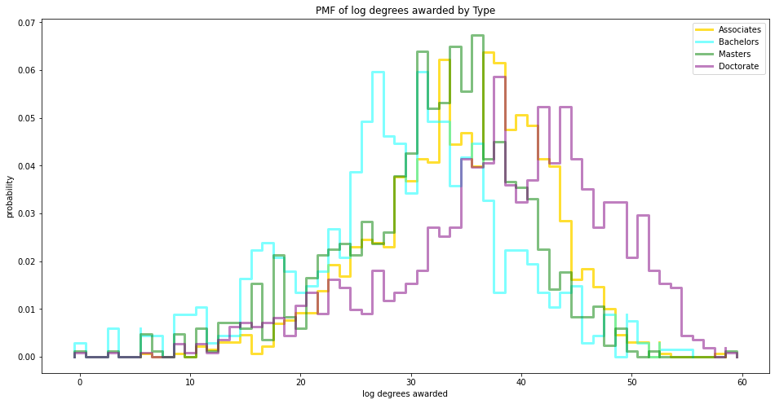
PMF, log10 degrees awarded by school Scenarios: Type of Degree (Associate’s, Bachelor’s, Master’s, Doctorate)
The PMF indicates that schools that offer doctoral degrees as their highest award tend to have more awards overall. This makes sense if those schools award all the lower degrees as well, which is common.

Slide 17
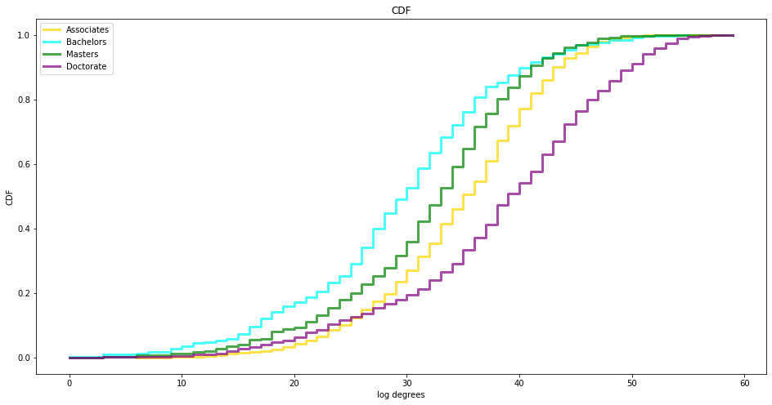
CDF, log degrees awarded by school Scenarios: Type of Degree (Associate’s, Bachelor’s, Master’s, Doctorate)

Slide 18
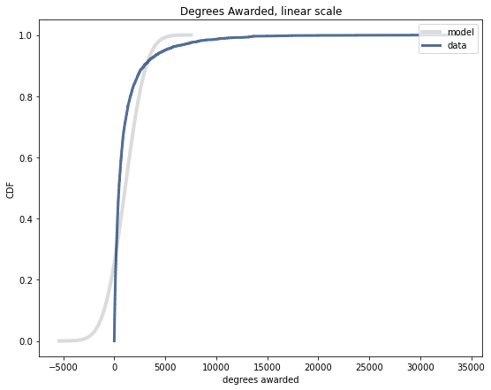
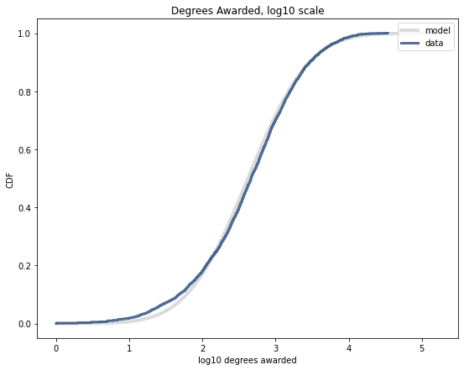
Linear vs. Lognormal Model Variable: Degrees Awarded
As confirmed by the plots of different transformations to the histograms, the data for the number of degrees awarded is best used with a lognormal model.

Slide 19
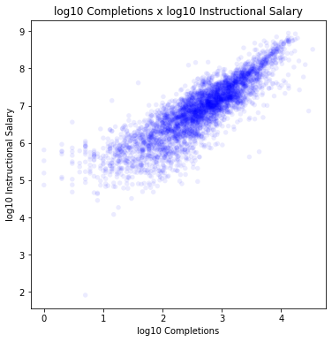
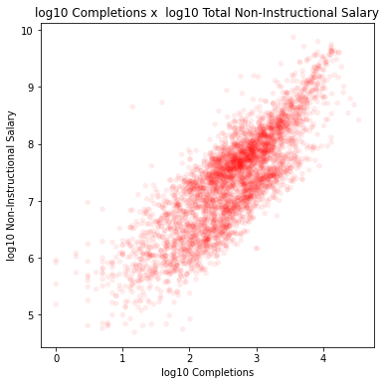
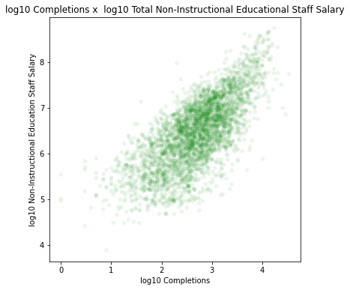
Scatterplots Salary / Completions
Instructional Staff Non-Instructional Staff Educational Services Staff
Correlation for Instructional Staff Salary and Completions: nan
Correlation for Non-Instructional Staff Salary and Completions: nan
Correlation for Educational Support Staff Salary and Completions: nan
Covariance for Instructional Staff Salary and Completions: nan
Covariance for Non=Instructional Staff Salary and Completions: nan
Covariance for Educational Support Staff Salary and Completions: nan

Slide 20
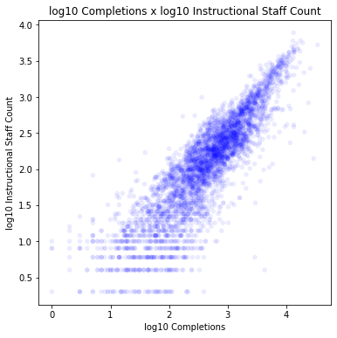
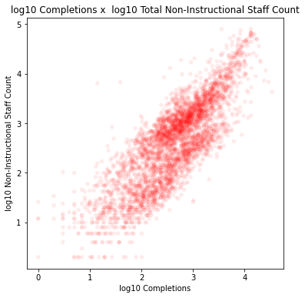
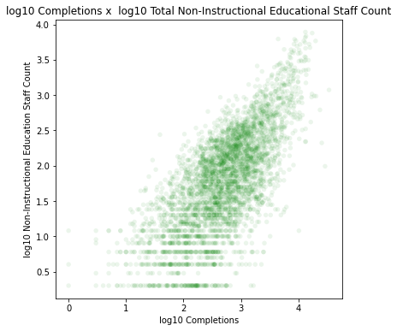
Scatterplots Total Staff / Completions
Instructional Staff Non-Instructional Staff Educational Services Staff
Correlation for Instructional Staff Count and Completions: 0.8655697651126324
Correlation for Non-Instructional Staff Count and Completions: nan
Correlation for Educational Support Staff Count and Completions: nan
Cov for Instructional Staff Count and Completions: 0.8655697651126324
Cov for Non=Instructional Staff Count and Completions: nan
Cov for Educational Support Staff Count and Completions: nan

Slide 21
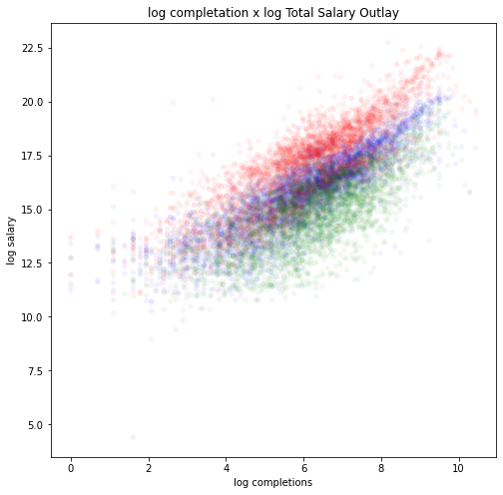
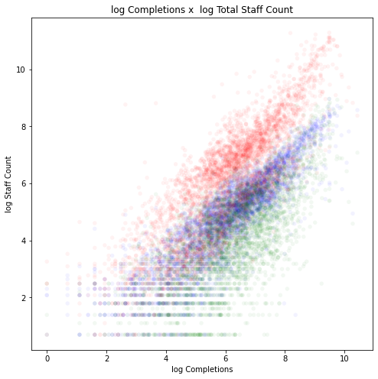

Scatterplots Combined
Based on the plot, a log transformation shows positive linear relationships between both salaries and completions and staff count and completions. In both cases non-instructional staff are paid more than instructional staff. Educational support staff, a subgrouping of non-instructional staff, are both less numerous and paid less. This group excludes all administrative roles, marketing, sales, and research staff, and any others that would not generally contribute to educational outcomes directly.

Slide 22
Hypothesis Testing Total Instructor Count vs. Completions
Result of Means Difference Permutation Test: 0.0
Actual correlation: 0.8655697651126326
Largest value in simulation: 0.0572413279170969
Result of One-Sided Means Difference Test: 0.0
Actual correlation: 1.316431385767003
Largest value in simulation: 0.11165839128655808
Result of Correlation Permutation Test: 0.0
Actual correlation: 0.571718886642882
Largest value in simulation: 0.06007399974966399
Result of Difference of Standard Deviation Test: 0.31
Result of False Negative Rate Test: 0.0

Slide 23
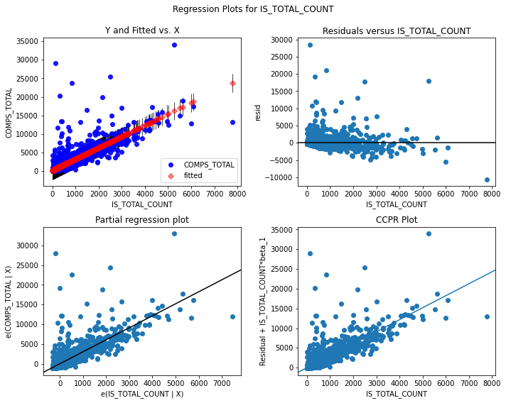
Regression Results
Model 1: Original Data, Count of Instructional Staff
Formula: COMPS_TOTAL ~ IS_TOTAL_COUNT
OLS Regression Results
Dep. Variable: | COMPS_TOTAL | R-squared: | 0.690
Model: | OLS | Adj. R-squared: | 0.690
Method: | Least Squares | F-statistic: | 8739.
Date: | Sun, 28 Feb 2021 | Prob (F-statistic): | 0.00
Time: | 23:50:44 | Log-Likelihood: | -33530.
No. Observations: | 3929 | AIC: | 6.706e+04
Df Residuals: | 3927 | BIC: | 6.708e+04
Df Model: | 1
Covariance Type: | nonrobust
 | coef | std err | t | P>|t| | [0.025 | 0.975]
Intercept | 210.7727 | 22.310 | 9.448 | 0.000 | 167.033 | 254.513
IS_TOTAL_COUNT | 3.0382 | 0.033 | 93.480 | 0.000 | 2.975 | 3.102
Omnibus: | 5913.164 | Durbin-Watson: | 1.855
Prob(Omnibus): | 0.000 | Jarque-Bera (JB): | 3746728.411
Skew: | 9.055 | Prob(JB): | 0.00
Kurtosis: | 153.195 | Cond. No. | 780.

Slide 24
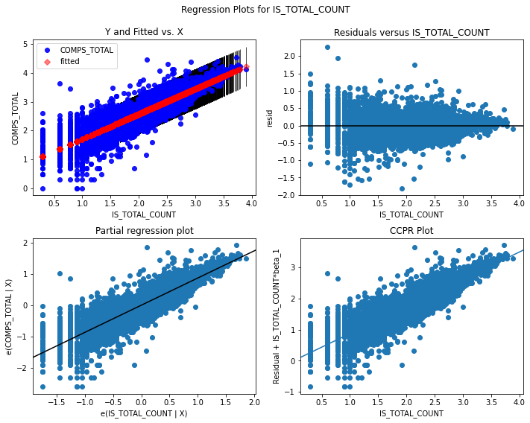
Regression Results
Model 2: log10 Data, Count of Instructional Staff
Formula: np.log(COMPS_TOTAL) ~ np.log(IS_TOTAL_COUNT)
OLS Regression Results
Dep. Variable: | COMPS_TOTAL | R-squared: | 0.749
Model: | OLS | Adj. R-squared: | 0.749
Method: | Least Squares | F-statistic: | 1.173e+04
Date: | Sun, 28 Feb 2021 | Prob (F-statistic): | 0.00
Time: | 23:50:28 | Log-Likelihood: | -1450.0
No. Observations: | 3929 | AIC: | 2904.
Df Residuals: | 3927 | BIC: | 2917.
Df Model: | 1
Covariance Type: | nonrobust
 | coef | std err | t | P>|t| | [0.025 | 0.975]
Intercept | 0.8344 | 0.017 | 48.034 | 0.000 | 0.800 | 0.868
IS_TOTAL_COUNT | 0.8715 | 0.008 | 108.312 | 0.000 | 0.856 | 0.887
Omnibus: | 235.489 | Durbin-Watson: | 1.710
Prob(Omnibus): | 0.000 | Jarque-Bera (JB): | 999.890
Skew: | -0.075 | Prob(JB): | 7.53e-218
Kurtosis: | 5.467 | Cond. No. | 8.03

Slide 25
Multiple Regression Results
Model 3: log Data, Count by Employee Type
Formula: 'COMPS_TOTAL~IS_TOTAL_COUNT+NIS_TOTAL+NIS_ED_TOTAL'
Model 4: log Data, Salary Outlay by Employee Type
Formula: 'COMPS_TOTAL~IS_SALARY+NIS_SALARY+NIS_ED_SALARY'
OLS Regression Results
Dep. Variable: | COMPS_TOTAL | R-squared: | 0.753
Model: | OLS | Adj. R-squared: | 0.753
Method: | Least Squares | F-statistic: | 3684.
Date: | Mon, 01 Mar 2021 | Prob (F-statistic): | 0.00
Time: | 01:01:58 | Log-Likelihood: | -1034.6
No. Observations: | 3622 | AIC: | 2077.
Df Residuals: | 3618 | BIC: | 2102.
Df Model: | 3
Covariance Type: | nonrobust
OLS Regression Results
Dep. Variable: | COMPS_TOTAL | R-squared: | 0.735
Model: | OLS | Adj. R-squared: | 0.735
Method: | Least Squares | F-statistic: | 3349.
Date: | Mon, 01 Mar 2021 | Prob (F-statistic): | 0.00
Time: | 01:03:16 | Log-Likelihood: | -1163.0
No. Observations: | 3622 | AIC: | 2334.
Df Residuals: | 3618 | BIC: | 2359.
Df Model: | 3
Covariance Type: | nonrobust
 | coef | std err | t | P>|t| | [0.025 | 0.975]
Intercept | 0.8859 | 0.020 | 43.971 | 0.000 | 0.846 | 0.925
IS_TOTAL_COUNT | 0.8522 | 0.021 | 41.133 | 0.000 | 0.812 | 0.893
NIS_TOTAL | -0.0609 | 0.021 | -2.873 | 0.004 | -0.102 | -0.019
NIS_ED_TOTAL | 0.0903 | 0.015 | 6.146 | 0.000 | 0.061 | 0.119
 | coef | std err | t | P>|t| | [0.025 | 0.975]
Intercept | -2.6018 | 0.054 | -48.600 | 0.000 | -2.707 | -2.497
IS_SALARY | 0.7184 | 0.021 | 34.749 | 0.000 | 0.678 | 0.759
NIS_SALARY | -0.0220 | 0.023 | -0.977 | 0.329 | -0.066 | 0.022
NIS_ED_SALARY | 0.0724 | 0.015 | 4.814 | 0.000 | 0.043 | 0.102
Omnibus: | 194.354 | Durbin-Watson: | 1.783
Prob(Omnibus): | 0.000 | Jarque-Bera (JB): | 738.099
Skew: | 0.083 | Prob(JB): | 5.29e-161
Kurtosis: | 5.205 | Cond. No. | 22.7
Omnibus: | 145.392 | Durbin-Watson: | 1.809
Prob(Omnibus): | 0.000 | Jarque-Bera (JB): | 411.303
Skew: | -0.133 | Prob(JB): | 4.86e-90
Kurtosis: | 4.629 | Cond. No. | 118.

Slide 26
Multiple Regression Results
Model 5: log Data
Formula: np.log(COMPS_TOTAL)~np.log(IS_TOTAL_COUNT)+np.log(IS_SALARY)+np.log(NIS_TOTAL)+np.log(NIS_SALARY)+HDEGOFR1+OB’EREG+np.log(NIS_ED_TOTAL)+np.log(NIS_ED_SALARY)
OLS Regression Results
Dep. Variable: | np.log10(COMPS_TOTAL) | R-squared: | 0.799
Model: | OLS | Adj. R-squared: | 0.798
Method: | Least Squares | F-statistic: | 713.7
Date: | Mon, 01 Mar 2021 | Prob (F-statistic): | 0.00
Time: | 16:16:56 | Log-Likelihood: | -666.54
No. Observations: | 3616 | AIC: | 1375.
Df Residuals: | 3595 | BIC: | 1505.
Df Model: | 20
Covariance Type: | nonrobust
 | coef | std err | t | P>|t| | [0.025 | 0.975]
Intercept | -1.8484 | 0.278 | -6.660 | 0.000 | -2.393 | -1.304
HDEGOFR1[T.12] | -0.0015 | 0.023 | -0.066 | 0.947 | -0.046 | 0.043
HDEGOFR1[T.13] | -0.0733 | 0.023 | -3.131 | 0.002 | -0.119 | -0.027
HDEGOFR1[T.14] | -0.1377 | 0.041 | -3.376 | 0.001 | -0.218 | -0.058
HDEGOFR1[T.20] | -0.0527 | 0.019 | -2.707 | 0.007 | -0.091 | -0.015
HDEGOFR1[T.30] | -0.0589 | 0.021 | -2.777 | 0.006 | -0.100 | -0.017
HDEGOFR1[T.40] | 0.2310 | 0.020 | 11.396 | 0.000 | 0.191 | 0.271
OBEREG[T.2.0] | 0.0302 | 0.024 | 1.285 | 0.199 | -0.016 | 0.076
OBEREG[T.3.0] | 0.0738 | 0.024 | 3.076 | 0.002 | 0.027 | 0.121
OBEREG[T.4.0] | 0.0696 | 0.026 | 2.686 | 0.007 | 0.019 | 0.120
OBEREG[T.5.0] | 0.1158 | 0.023 | 5.008 | 0.000 | 0.070 | 0.161
OBEREG[T.6.0] | 0.1374 | 0.026 | 5.273 | 0.000 | 0.086 | 0.188
OBEREG[T.7.0] | 0.1183 | 0.033 | 3.589 | 0.000 | 0.054 | 0.183
OBEREG[T.8.0] | 0.1684 | 0.024 | 7.006 | 0.000 | 0.121 | 0.215
OBEREG[T.9.0] | 0.2567 | 0.042 | 6.095 | 0.000 | 0.174 | 0.339
np.log(IS_TOTAL_COUNT) | 0.7956 | 0.057 | 13.910 | 0.000 | 0.683 | 0.908
np.log(IS_SALARY) | -0.1691 | 0.054 | -3.122 | 0.002 | -0.275 | -0.063
np.log(NIS_TOTAL) | -0.5219 | 0.086 | -6.041 | 0.000 | -0.691 | -0.353
np.log(NIS_SALARY) | 0.6799 | 0.087 | 7.828 | 0.000 | 0.510 | 0.850
np.log(NIS_ED_TOTAL) | 0.0745 | 0.062 | 1.194 | 0.232 | -0.048 | 0.197
np.log(NIS_ED_SALARY) | 0.0162 | 0.062 | 0.263 | 0.793 | -0.105 | 0.137
Omnibus: | 255.774 | Durbin-Watson: | 1.800
Prob(Omnibus): | 0.000 | Jarque-Bera (JB): | 1265.318
Skew: | 0.092 | Prob(JB): | 1.74e-275
Kurtosis: | 5.892 | Cond. No. | 756.

Slide 27
Multiple Regression Results
Model 6: log Data
Formula: 'np.log(COMPS_TOTAL)~np.log(IS_TOTAL_COUNT)+np.log(IS_SALARY)+np.log(NIS_SALARY)+HDEGOFR1+OBEREG'
OLS Regression Results
Dep. Variable: | np.log(COMPS_TOTAL) | R-squared: | 0.803
Model: | OLS | Adj. R-squared: | 0.802
Method: | Least Squares | F-statistic: | 933.5
Date: | Mon, 01 Mar 2021 | Prob (F-statistic): | 0.00
Time: | 16:24:41 | Log-Likelihood: | -928.77
No. Observations: | 3907 | AIC: | 1894.
Df Residuals: | 3889 | BIC: | 2006.
Df Model: | 17
Covariance Type: | nonrobust
 | coef | std err | t | P>|t| | [0.025 | 0.975]
Intercept | -0.8218 | 0.198 | -4.146 | 0.000 | -1.210 | -0.433
HDEGOFR1[T.12] | -0.0021 | 0.024 | -0.088 | 0.930 | -0.048 | 0.044
HDEGOFR1[T.13] | -0.0663 | 0.024 | -2.753 | 0.006 | -0.114 | -0.019
HDEGOFR1[T.14] | -0.1360 | 0.041 | -3.298 | 0.001 | -0.217 | -0.055
HDEGOFR1[T.20] | -0.0489 | 0.020 | -2.449 | 0.014 | -0.088 | -0.010
HDEGOFR1[T.30] | -0.0567 | 0.022 | -2.611 | 0.009 | -0.099 | -0.014
HDEGOFR1[T.40] | 0.2667 | 0.020 | 13.168 | 0.000 | 0.227 | 0.306
OBEREG[T.2.0] | -0.0056 | 0.024 | -0.236 | 0.814 | -0.053 | 0.041
OBEREG[T.3.0] | 0.0483 | 0.025 | 1.966 | 0.049 | 0.000 | 0.096
OBEREG[T.4.0] | 0.0510 | 0.026 | 1.938 | 0.053 | -0.001 | 0.103
OBEREG[T.5.0] | 0.0951 | 0.023 | 4.081 | 0.000 | 0.049 | 0.141
OBEREG[T.6.0] | 0.1172 | 0.026 | 4.462 | 0.000 | 0.066 | 0.169
OBEREG[T.7.0] | 0.1058 | 0.034 | 3.146 | 0.002 | 0.040 | 0.172
OBEREG[T.8.0] | 0.1774 | 0.025 | 7.226 | 0.000 | 0.129 | 0.226
OBEREG[T.9.0] | 0.1852 | 0.040 | 4.584 | 0.000 | 0.106 | 0.264
np.log(IS_TOTAL_COUNT) | 0.5426 | 0.045 | 12.069 | 0.000 | 0.454 | 0.631
np.log(IS_SALARY) | -0.0040 | 0.043 | -0.093 | 0.926 | -0.089 | 0.081
np.log(NIS_SALARY) | 0.3028 | 0.017 | 17.700 | 0.000 | 0.269 | 0.336
Omnibus: | 235.244 | Durbin-Watson: | 1.775
Prob(Omnibus): | 0.000 | Jarque-Bera (JB): | 1025.933
Skew: | -0.029 | Prob(JB): | 1.66e-223
Kurtosis: | 5.510 | Cond. No. | 438.

Slide 28
Model Findings
Only Total Instructional Staff Salary and Non-Instructional Staff Totals have negative coefficients (-0.1567 and -0.5646 respectively) of the non-categorical variables according to Model 5
Model 6 variables were chosen by trail and error to maximize the R² output
The only correlation test that returned a result that was not 0.0 was ‘Correlation for Instructional Staff Count and Completions’, indicating a possible error in calculations done on log transformed data.
R² for model with all variables has highest value, lowest AIC and lowest Skew, indicating that model is the best for predicting completions
Adding HDEGOFR1 and OBEREG to any model increases the R², indicating geographic region and highest award offered by an institution are significant for improving the model
A test model not included in this table included a computed field of the mean salaries by staff group, but the R² was only 0.19

Slide 29
Python Packages Used:
pandas
numpy
statsmodels.formula.api
thinkstats2
thinkplot
Matplotlib
statistics
statsmodels.api

